Slide 1
The Visual System in Flight

Slide 2

Visual Test

Slide 3
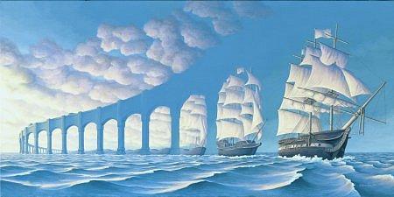

Slide 4
What did you see?

Slide 6
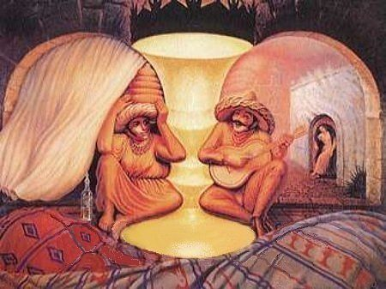

Slide 7
What did you see?

Slide 9
What do you see?

Slide 10
What did you see?

Slide 11
Now what can you see?

Slide 12

You Need to Focus

Slide 13
Terminal Learning Objective
Action: Manage the effects of visual limitations during flight
Conditions: While performing as an aircrew member
Standards: IAW TC 3-04.93, FM 3-04.203, Fundamentals of Aerospace Medicine, 3rd Ed., and Aeromedical Policy Letter (APL) entitled Corneal Refractive Surgery dated 12 Feb 07

Slide 14
Administrative Information
Risk Assessment: Low
Environmental Considerations: None
Safety Considerations: None
Evaluation: 50 Question exam at the end of Aeromedical Training at USASAM
Notes:
SAFETY REQUIREMENTS: None.
RISK ASSESSMENT LEVEL: Low.
ENVIRONMENTAL CONSIDERATIONS: None.

Slide 15
ELO A
Action: Identify the components of the eye and its functions
Conditions: Given a list
Standards: IAW TC 3-04.93
Notes:
2
2

Slide 16
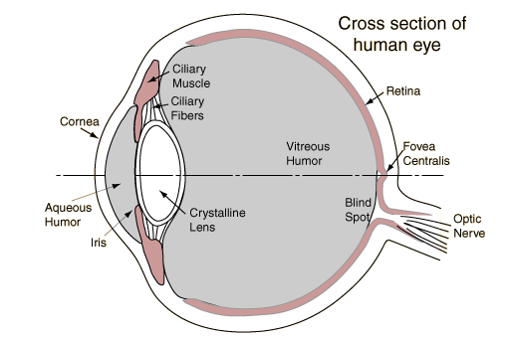
Anatomy of the Eye – Cornea
Notes:
2
2
The cornea is a transparent, colorless protective tissue, consisting of collagen fibers, located over the front of the eye. The strength of the cornea as a protective covering lies in the fact that it is kept well hydrated by an endothelial pump action. Since the cornea contains no blood vessels, it receives its primary oxygen supply through a tear film action.
As light travels, it initially enters the eyes through the cornea and then continues toward the iris.

Slide 17
Iris
Notes:
2
2
The iris is the round, pigmented (colored) membrane that surrounds the pupil. For example, if an individual has green, brown, or hazel eyes, this colored portion is the iris.
The iris contains ciliary muscle, which is controlled by the parasympathetic nervous system to automatically adjust the size of the pupil and regulate the amount of light entering the eye. Bright light can reduce the pupil diameter to as little as 1.5mm. At the other end of the spectrum, when it is dark, the iris can open the pupil up to 8mm wide, almost six times it’s minimum size. This leads us to the next component -- the pupil.

Slide 18
Pupil
Pupil
Notes:
2
2

Slide 19
Lens
Notes:
2
2
The lens is a transparent, bi-convex membrane held in place by zonular fibers in the lens capsule and is positioned directly behind the pupil. The lens capsule flexes the lens so the light entering the eye is properly focused on the retinal wall.
When individuals are in their twenties, the lens is fairly elastic and flexible with a 15-diopter range of refractive power. But as individuals reach their late forties, the lens begins to harden and the diopter range can be reduced to as low as 4- diopters. This condition is commonly referred to as Presbyopia.
Virtually all of the components of the eye are designed to package the light for delivery to the retinal wall.

Slide 20
Retina
Notes:
2
2
The retina is a thin, ten layered membrane, also known as Jacob’s membrane, which covers most of the posterior portion of the eye. The retina contains the photoreceptor cells known as rods and cones. The retina also contains a coloring tint called rhodopsin, or visual purple, which allows the rod cells to function under low light conditions.
Let's focus on where the cones and rods are located.

Slide 21
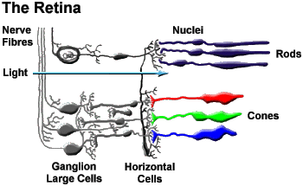
Photoreceptor Cells
Cone cells:
  Used in periods of bright light
  Identifies colors
  Sharp visual acuity and color sense
  7 million in fovea and parafoveal regions
  1:1 ratio of cone cells to neuron cells
  Produces Iodopsin
Rod cells:
  Used in periods of low ambient light and darkness
  Identifies outline of shapes and silhouettes
  Poor color sense and visual acuity
  120 million rod cells
  10:1 to 10,000:1ratio of rod cells to neuron cells
  Produces Rhodopsin (Visual Purple)

Slide 22
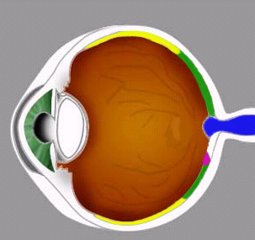
Retina Overview
Peripheral
Parafoveal
Fovea Centralis
Optic Nerve
Parafoveal
Peripheral

Slide 23
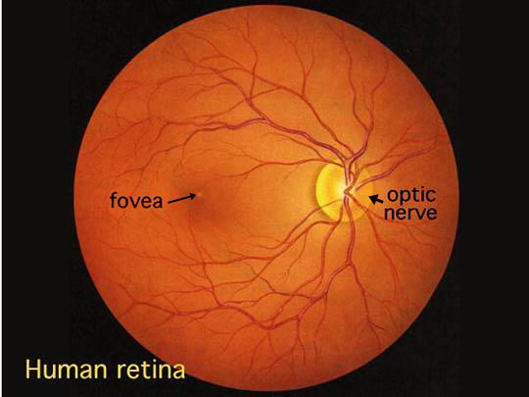
Fovea Centralis
Notes:
2
2
Within the retina, the cone cells are mostly located within the region known as the fovea centralis. This region contains only cone cells which provide day color vision. The Macula, which is located at the very center of the fovea, has the highest concentration of cones, containing approximately 47,000 cones per square millimeter.
Interestingly the fovea is located about 15° off center from the optic disc. The basic reason for being off center is because of the optic disk, which is the point where the optic nerve attaches to the retina, causing it to be essentially in the way of vision. Since there are no rod or cone cells at this point, it is referred to as a blind spot.
Therefore, because the retina is off-center, the ability of the lens to bend (or refract) incoming light to the center of the fovea is absolutely critical for sharp 20/20 vision.
As previously discussed, and when the optometrist or flight surgeon talks about glasses or contacts, they often refer to the amount of diopters that the glasses will provide. These are units of refraction to bend the light for placement on the fovea.
As we move away from the center of the fovea or macula, the concentration of cone cell decreases. Therefore the fovea centralis is where our direct or central vision resides. This small area is where 85% of all information is processed to accomplish a mission, whether flying by VFR or by instruments, or by even using a computer to read this material.
The "cones are responsible for colored vision and the recognition of details under normal illumination. The distribution of the two types of receptors on the retina is interesting. The rods are concentrated at the edge, whereas the cones are almost exclusively concentrated at one point, the Fovea centralis. This tiny area, which has a diameter of only 2 mm, is responsible for clear vision. If we want to observe an object precisely, we fix our eyes so that the object's image falls in the area of the Fovea. At the same time we see another part of the object, which is pictured in the peripheral area of the retina, unclearly

Slide 24
Optic Nerve
Notes:
2
2
As we mentioned earlier, located near the fovea is the optic disk. This is the point where the optic nerve takes the electrical input from the retinal images and transports those signals to the brain. However, since there are no rod or cone cells at this location, a blind spot is created in our vision.
Fortunately our vision is not limited to the fovea centralis, for we would lack visual spatial orientation without peripheral vision. Peripheral vision occurs in the region known as the parafoveal, which we will discuss in greater detail on the next slide.

Slide 25
Retinal Blind Spots
Day blind spot:
  Related to position of optic disc on the retina
  Located 15 degrees from fovea
  No photoreceptor cells (rods or cones)
  Encompasses 5.5 to 7.5 degrees of visual field
  Compensate with binocular vision
Night blind spot:
  Located in central viewing axis (fovea)
  Absence of rod cells in fovea
  Inability of cone cell function
  Encompasses an area of 5 to 10 degrees of central, visual field
  Viewer must scan to compensate

Slide 26
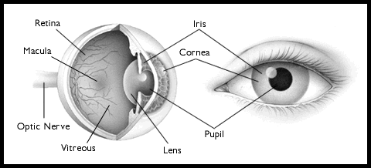
Anatomy Review
Fovea
Centralis

Slide 27
QUESTIONS?
Notes:
95

Slide 28
ELO B
Action: Identify the common visual deficiencies
Conditions: Given a list
Standards : IAW TC 3-04.93, AR 40-501
Notes:
2
2

Slide 29
Visual Deficiencies
Astigmatism
Myopia
Hyperopia
Presbyopia
Notes:
2
2

Slide 30
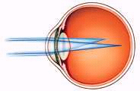

Astigmatism
Due to irregularities of the cornea, observer cannot focus on vertical and horizontal features at the same time
Notes:
2
2

Slide 31
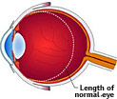

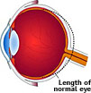

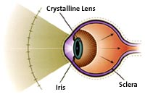
Visual Deficiencies
Myopia: Nearsightedness
Hyperopia: Farsightedness
Presbyopia: (aging)
Hardening of lens,
loss of elasticity

Slide 32
QUESTIONS?
Notes:
95

Slide 33
ELO C
Action: Identify the corneal refractive surgical procedures that are currently acceptable in Army Aviation
Conditions: Given a list
Standards : IAW AR 40-501 and APL entitled Corneal Refractive Surgery dated 12 Feb 07
Notes:
2
2

Slide 34
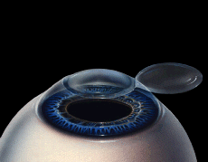
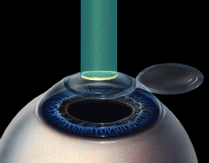
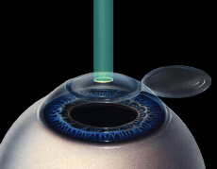
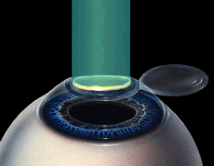
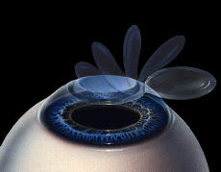
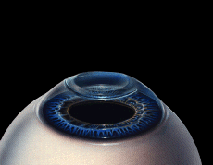
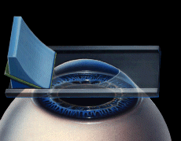
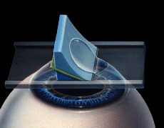
Allowable Refractive Surgeries
PRK – Photorefractive Keratectomy
  PRK has slower return to duty time, but is less susceptible to flap issues
LASIK – Laser in Situ Keratomileusis
  LASIK is now the most commonly performed procedure
LASEK – Laser Subepithelial Keratomileusis
  Similar to PRK; carving and reshaping of corneas that are too thick or too flat to use LASIK surgery

Slide 35
QUESTIONS?
Notes:
95

Slide 36
ELO D
Action: Identify the types of vision
Conditions: Given a list
Standards : IAW TC 3-04.93
Notes:
2
2

Slide 37
Types of Vision
Photopic Vision
Mesopic Vision
Scotopic Vision

Slide 38
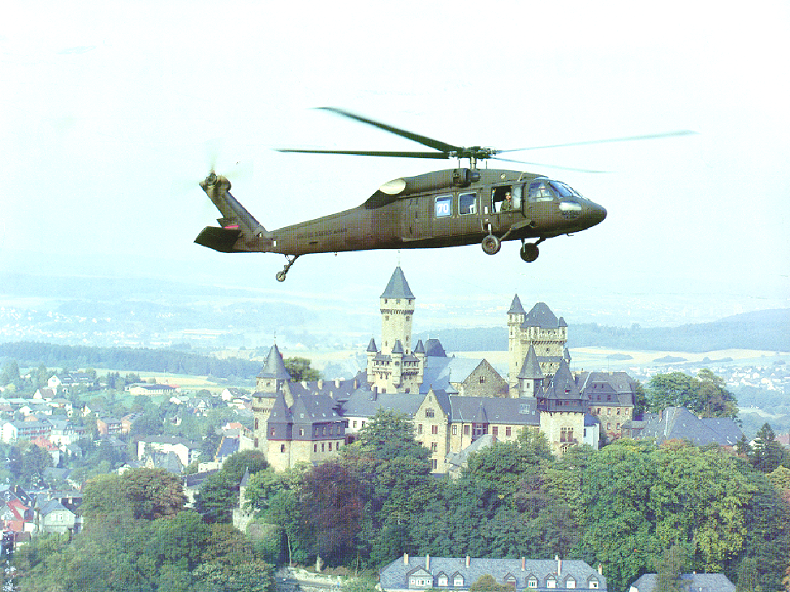
Photopic Vision
Daylight or bright light
Central vision
Color sense and image sharpness
Visual acuity 20/20
Notes:
2
2

Slide 39
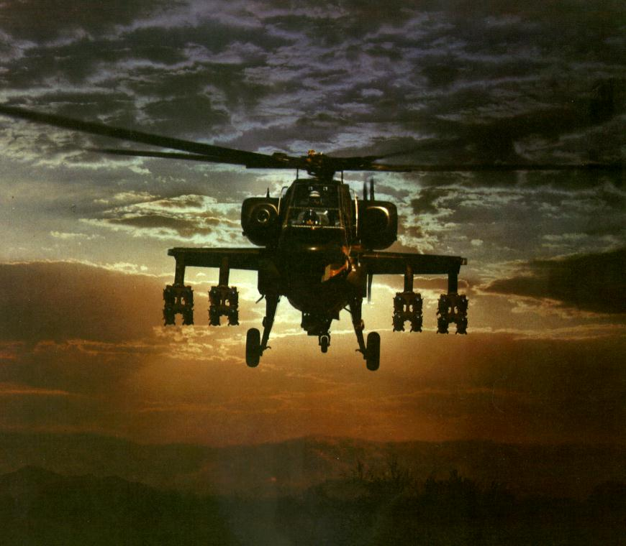
Mesopic Vision
Dawn, dusk, and full moonlight
Parafoveal regions (rods and cones)
Decreased visual acuity and color sense

Slide 40
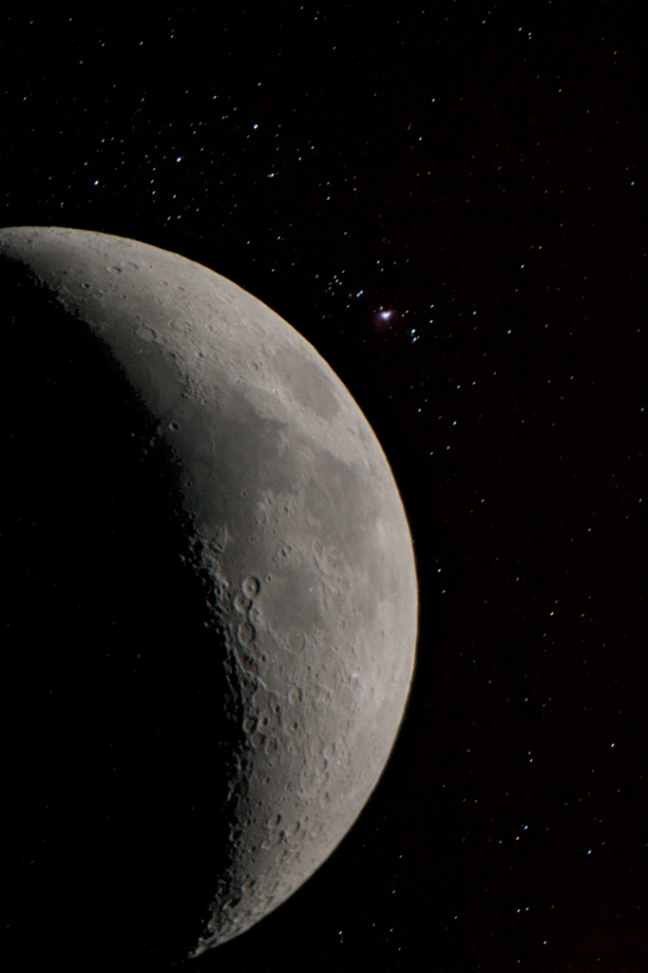
Scotopic Vision
Night vision (partial moon and star light)
Peripheral vision (rods only)
Acuity degraded to silhouette recognition
Loss of color perception
Off center viewing (scanning)

Slide 41
QUESTIONS?
Notes:
95

Slide 42
ELO E
Action: Identify the cues to distance estimation and depth perception
Conditions: Given a list
Standards : IAW TC 3-04.93
Notes:
2
2

Slide 43
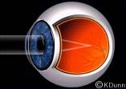
Binocular Cues
Valuable only when object is close
Each eye has a slightly different view
Operates subconsciously
Little value in flight environment
Notes:
2
2

Slide 44
Visual Cues
Monocular Cues: G R A M
  Geometric perspective: L A V
  Retinal image size: K I T O
  Aerial perspective: F L P
  Motion parallax: most important cue to depth
  perception

Slide 45
Geometric Perspective
Objects have different shapes when viewed at varying distances and altitudes

Slide 46

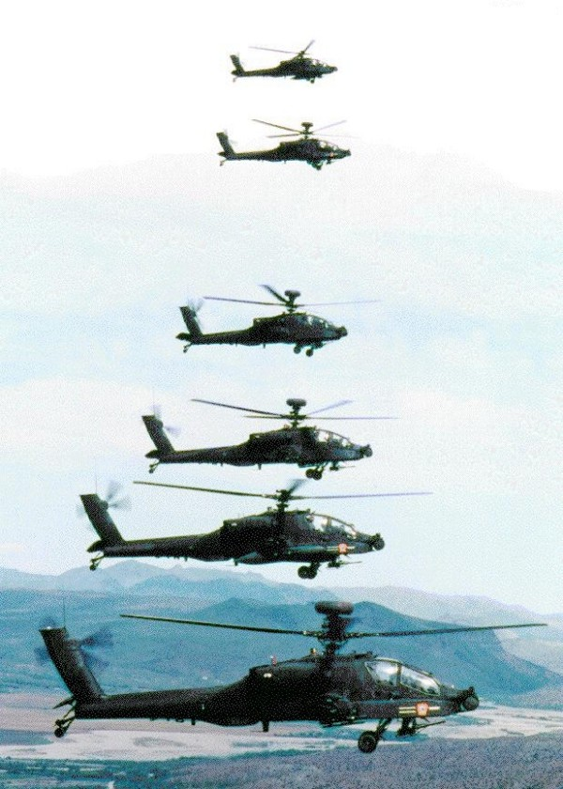
Geometric Perspective
Linear
perspectives
Apparent
foreshortening
Vertical position
in the field
Notes:
2
2

Slide 47
Retinal Image Size
Known size of objects
Increasing or decreasing size of objects
Terrestrial association
Overlapping contours
Notes:
2
2

Slide 48
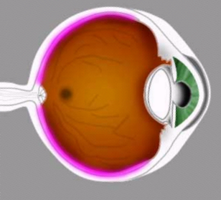
Known Size of Objects
5 Degrees
30 Ft
1000 FT
30 Ft
10 Degrees
500 FT
Notes:
2
2

Slide 49
Increase (or Decrease) in Size
INCREASE IN SIZE
DECREASE IN SIZE
Notes:
2
2

Slide 50
Terrestrial Association
Eye
Notes:
2
2

Slide 51
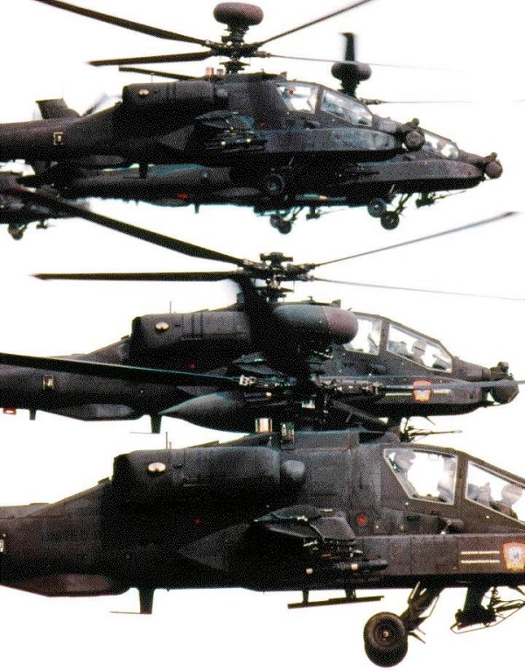
Overlapping Contours
Notes:
2
2

Slide 52
Aerial Perspective
An object’s clarity and its shadow are perceived by the brain as cues for estimating distance
Notes:
2
2

Slide 53
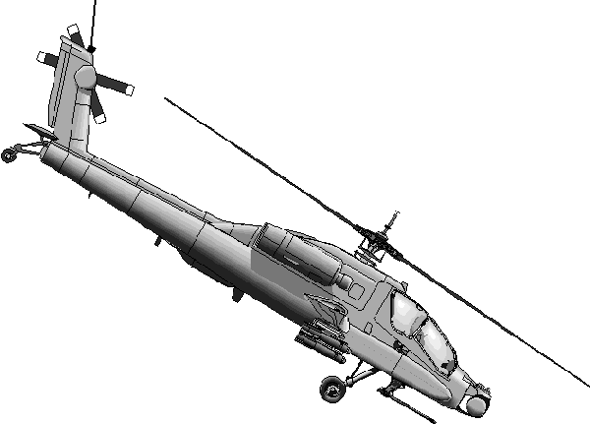
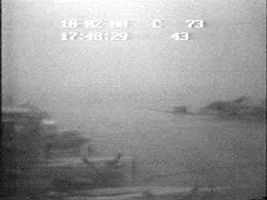
Fading of Colors and Shades
Notes:
25

Slide 54

Loss of Detail or Texture
Notes:
2
2
Note that up close, you can see the blades of grass, but increase the distance and you see a solid green field.

Slide 55
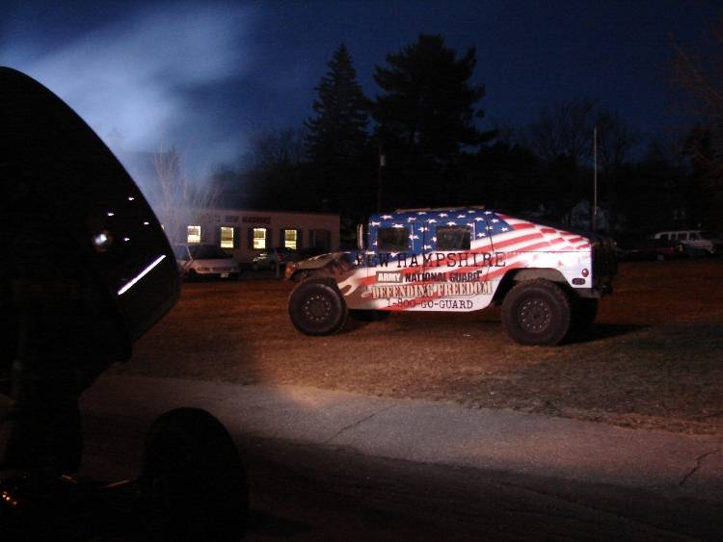
Position of Light Source and Direction of Shadow
Notes:
Shadow cast away from the observer, therefore light source is closer than object.

Slide 56
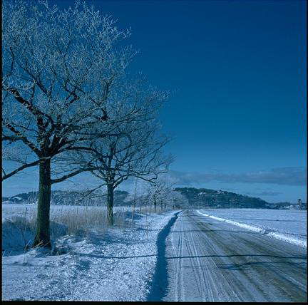
Motion Parallax
Most important cue to depth perception
  Stationary objects
  Observer moving
Rate depends on the relative distance of the object
from the observer
Click to view motion parallax
Notes:
2
2

Slide 57
QUESTIONS?
Notes:
95

Slide 58
ELO F
Action: Identify limitations to night vision
Condition: Given a list of night vision limitations
Standard: IAW TC 3-04.93 and FM 3-04.203

Slide 59
Limitations of Night Vision
Depth perception (safe landings)
Visual acuity (obstacle identification)
Night blind spot
Dark adaptation (time factor)
Color perception
Night myopia
Visual cues

Slide 60
Visual Acuity
20/200
20/200
20/20
20/20

Slide 61
Night Blind Spot
A 737 Jet
@ 3000 feet
Oil Barrel @ 100 feet
Dashboard Switch @ 3 feet
3’
12’
24’
35’
756’
Crewchief’s
Toolbox @ 30 feet
Chinook @ 1000 feet

Slide 62
Dark Adaptation
Average time required is 30-45 minutes
Exposure to intense sunlight , glare off sand, snow, or water for 2-5 hours will increase the time required to dark adapt, for up to 5 hours
After full dark adaptation, 3-5 minutes required to “re-dark adapt” if exposed to a brief, bright light
Vitamin A required for production of Rhodopsin
Notes:
***NOTE***
Glare does NOT increase dark adaptation time to 2-5 hours, it affects your dark adaptation after 2-5 hours exposure, for up to 5 hours. Per TC 3-04.93. Student Handout (Jun 10) will reflect this change.

Slide 63
Night Myopia
Blue wavelength light causes night myopia
  Image sharpness decreases as pupil diameter increases
  Mild refractive error factors combined, creates unacceptably blurred vision
  Focusing mechanism of the eye may move toward a resting position (increases myopic state)

Slide 64
Visual Illusions
Fascination (fixation) in flight
False horizon**
Flicker vertigo
Crater illusion**
Relative motion
Altered planes of reference
Size-distance illusion
Height-depth illusion
Confusion with ground lights**
Structural illusions
Autokinetic illusion **
Reversible perspective **
**Demonstrated during
Night Vision Lab after break

Slide 65
ELO G
Action: Identify the methods to protect visual acuity from flight hazards
Conditions: Given a list
Standards : IAW TC 3-04.93
Notes:
2
2

Slide 66
Flight Hazards
Solar Glare
Bird Strikes
Lasers
Nerve Agents
Notes:
2
2

Slide 67
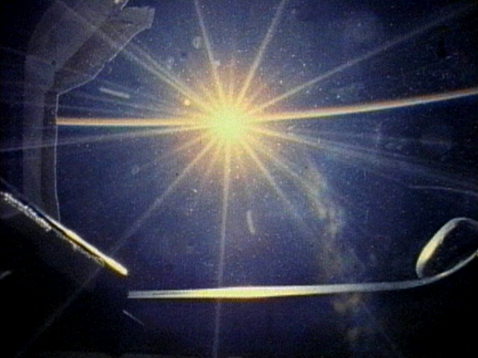
Solar Glare
Notes:
2
2

Slide 68
Bird Strikes
Notes:
2
2

Slide 69
L.A.S.E.Rs
Light Amplification by a Stimulated Emission of Radiation
  Intense, narrow beam of light, less than 1 inch in diameter
  Widens with distance: 2km-diameter is 2 meter
2Meters
2 Km
Notes:
2
2

Slide 70
Laser Injuries
Lens: focuses and concentrates light rays entering the eye
Concentration of energy through the lens is intensified 100,000 times greater than the normal light entering the eye
Amount of damage depends on laser type, exposure time, and distance from the laser
Types of injuries:
  Tiny lesions on the back of the eye
  Flash blindness
  Impaired night vision
  Severe burns effecting vast body portions
Notes:
2
2

Slide 71
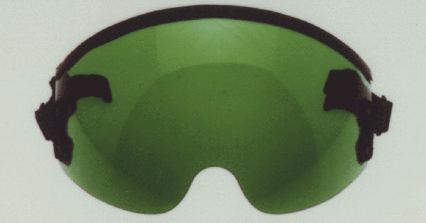
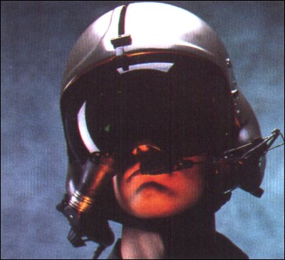
Laser Protective Measures
Passive:
  Take cover
  NVDs
  Squinting
  Protective goggles
Active:
  Counter measures taught or directed
  Evasive action
  Scanning with one eye or monocular optics
Notes:
2
2

Slide 72
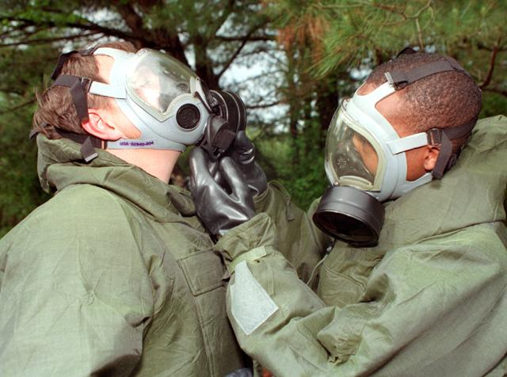
Nerve Agents
Threat present both day and night at low level flight
Consult flight surgeon immediately
Severity of miosis depends on agent concentration and cumulative effects of repeated exposure
  Direct or minute exposure will cause miosis (pupil constriction)
  Severe miosis may persist for 48 hrs
  Complete recovery may take up to 20 days
Notes:
2
2

Slide 73
QUESTIONS?
Notes:
95

Slide 74
ELO H
Action: Identify the effects of the self-imposed stresses
Conditions: Given a list
Standards: IAW TC 3-04.93, AR 40-8
Notes:
2
2

Slide 75
Self-imposed Stresses
Drugs
Exhaustion
Alcohol
Tobacco
Hypoglycemia
Notes:
2
2
Drugs: Avoid self-medicating; many OTC drugs will cause drowsiness and affect dark adaptation.
Exhaustion: affects ability to dark adapt and causes fascination/fixation; decreased scanning and attention to details.
Alcohol: 12 hours and no residual effects until you may resume flight duties; 1 ounce equivalent places you at 2,000 feet physiologically; Histotoxic hypoxia.
Tobacco: 20-40 cigarettes per day or 3 cigarettes in rapid succession, causes:
-5,000 feet physiological altitude
-20% decrease in night vision at sea level
-Hypemic hypoxia
Hypoglycemia: related to scanning and fixation, due to distraction caused by hunger pains. Vitamin A deficiency if it is a chronic case.

Slide 76
QUESTIONS?
Notes:
95

Slide 77
Check on Learning
Which part of the eye is for protection and which part regulates the amount of light entering the eye?
The Cornea and the Iris
What is hardening of the lens and occurs with aging?
Presbyopia
Which surgeries can you get a waiver for?
  PRK, LASIK, LASEK
Notes:
2
2

Slide 78
Check on Learning
What are the three types of vision?
Photopic, Mesopic, Scotopic
What is the R in GRAM?
Retinal image size
What are the two types of photoreceptor cells and their function?
Rods for night vision
Cones for color/day vision
What is the acronym for Self-imposed stresses?
DEATH
Notes:
2
2

Slide 79
Summary
Anatomy of the eye
Common visual deficiencies
Acceptable surgical procedures
Types of vision
Cues to depth perception
Visual limitations
Protection of visual acuity from flight hazards
Effects of self-imposed stresses
Notes:
2
2

